Slide 1
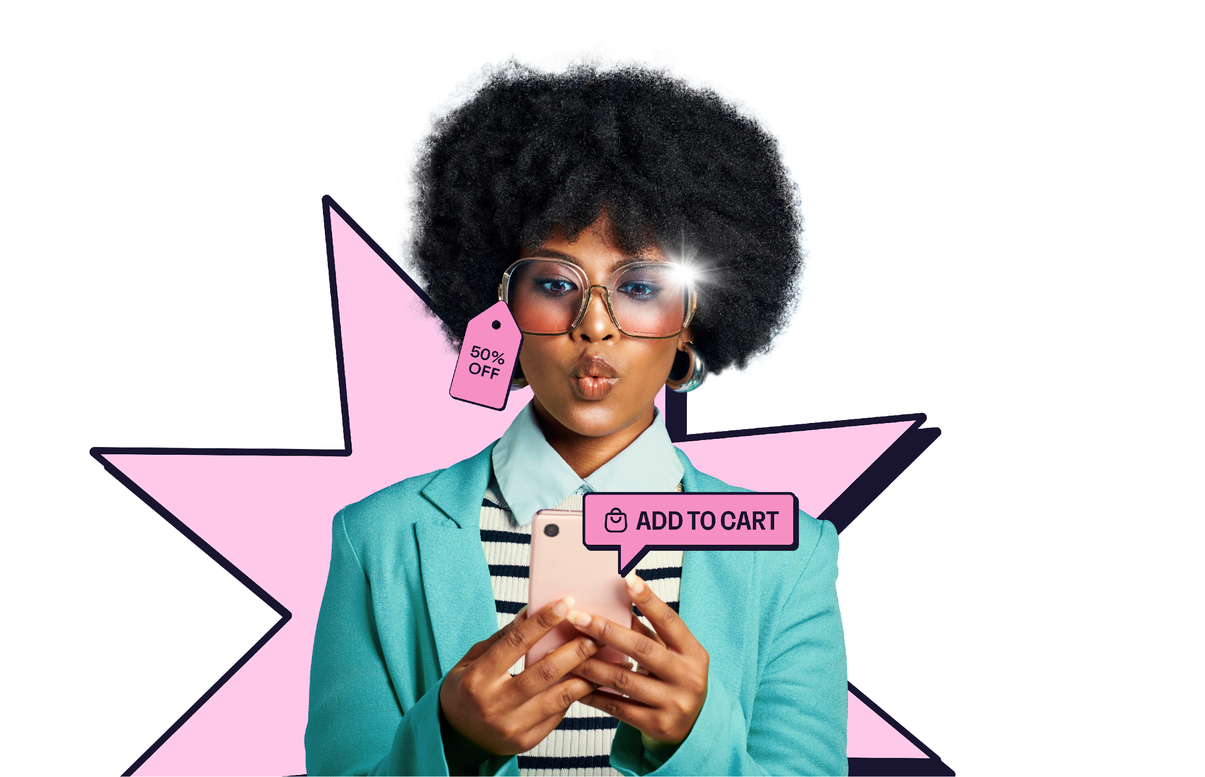
Swipe,
click, buy

Slide 2
Methodology
03.
04.
10.
14.
19.
20.
21.
Introduction
The new way to browse
The online shopping journey
The psychology of buying
Talking points
Want to know more?
More from GWI
All figures in this report come from GWI’s online research among internet users aged 16-64, so it’s fair to say they reflect the online populations of each market.
In some markets - mainly in Latin America, Middle East and Africa, and the Asia-Pacific region - low internet penetration means online populations tend to be younger, more affluent and better educated than the total population.
When reading this report, please note that we use a mixture of data from our ongoing quarterly global research, and insights from our Zeitgeist research, which is carried out in Australia, China, India, Japan, Singapore, Brazil, Canada, USA, France, Germany, Italy and the UK only.

Slide 3
The way people are shopping online is changing. From brand discovery to making purchases, different generations are doing so in a range of non-traditional methods.
Despite the ongoing global economic concerns, consumers continue to shop, utilizing new means like social commerce and AI to do this.
In this deck, we take a closer look at global trends, generational differences, and shine a spotlight on US consumers.
Please note you’ll only be able to click on the links in Slide Show mode. If you’re viewing this file in Edit mode, please right-click on the icon and select “Open Hyperlink”.

Slide 4
The new way to browse

Slide 5
A generational divide
E-commerce is popular with younger consumers
% in each generation who say they prefer to shop online
Gen Z like to find inspiration, baby boomers prefer to research
% in each generation who say the following are important reasons for using the internet
Source: GWI Core Q2 2023 Base: 237,677 internet users aged 16-64

Slide 6
Online inspiration for purchases is growing
The way people are finding products is changing. While search engines remain on top overall, algorithm-based recommendations on social media platforms are becoming increasingly popular. The convenience of inspiration/ recommendations waiting there for consumers is undeniable, and less hassle than seeking it out themselves.
Platforms like TikTok have been making their sites more shoppable with integrated purchase features. In accordance with the growth in demand for social browsing, search engine giant Google revamped their search tools to keep up with the need for a more visual approach to product discovery.
This trend has been driven significantly by younger consumers. 59% of Gen Z prefer to shop online, and 49% use the internet to find inspiration, compared to just 36% of boomers.
More are going online for inspiration
Rank based on the % who say the following are important reasons for using the internet
Q2 2019
Q2 2023
Finding information
Keeping up-to-date with news/events
Staying in touch with friends/family
Watching videos, TV shows or movies
Researching how to do things
Researching products/brands
Accessing/listening to music
Finding new ideas or inspiration
Filling up spare time/general browsing
Education/study-related purposes
Finding information
Staying in touch with friends/family
Watching videos, TV shows or movies
Keeping up-to-date with news/events
Researching how to do things
Finding new ideas or inspiration
Accessing/listening to music
Researching products/brands
Filling up spare time/general browsing
Education/study-related purposes
1
1
2
2
3
3
4
4
5
5
6
6
7
7
8
8
9
9
10
10
Source: GWI Core Q2 2019 & Q2 2023 Base: 377,335 internet users aged 16-64

Slide 7
Younger generations find brands on social
Social media is a popular discovery method for younger consumers
% in each generation who discover brands/products via the following methods
Source: GWI Core Q2 2023 Base: 237,677 internet users aged 16-64

Slide 8
The changing format of testimonies
The purchase journey is changing across generations. Starting from the beginning: when discovering brands; younger generations are more likely to lean on social media, whereas older generations are more likely to rely on TV ads and word-of-mouth. Baby boomers are also most likely to use search engines (36%)- they’ve now reached a level of comfort with these, rather than learning how to use newer platforms.
Consumer reviews will always be a trusted source of information, but the way younger generations are consuming reviews is changing. Brands should consider seeding product to vloggers early so they can promote them upon release.
Consumer reviews are changing
% in each generation who use the following
when looking for more information about brands/products
Source: GWI Core Q2 2023 Base: 237,677 internet users aged 16-64

Slide 9
The new way to search online
Gen Z are the most likely generation to use ChatGPT to search online
% of Gen Z (outside of China) who use the following platforms to search online, sorted by top over-index
Online search tools
% of consumers in each generation who use the following tools at least monthly
New ways of searching continue to pop up. ChatGPT has boomed recently, and Gen Z have quickly adopted it in their search behavior. As well as social platforms, AI-powered search poses more competition to traditional search, so it’s no surprise that we’ve seen Google and Bing quickly integrate the technology.
Millennials are the most comfortable using an AI integrated tool to buy a product/service (51%) and seeing ads when using AI tools (44%). It’ll be no surprise when ads start popping up on AI chat platforms, so brands should be ready to seize a new opportunity. Understanding where your audience is searching gives the best shot at catching them at the start of their purchase journey.
Average (1.00)
IDX
%
16%
4%
9%
28%
10%
7%
Source: GWI Zeitgeist May 2023 Base: 13,100 platform users aged 16-64 in 11 markets | 15,481 internet users aged 16-64 in 12 markets

Slide 10
It’s not just younger generations that use new methods
While younger generations are leading the way with new methods of search, baby boomers are also changing the platforms they use to search/shop online.
TikTok is now their fourth favorite platform, rising 4 places since 2021. Over the last 2 years, the number of baby boomer TikTok users in the US who have clicked on a sponsored/promoted ad has increased by 41%.
Reaching customers on social media through ads is a digital marketing staple, but mainly used for younger audiences. There’s now a growing opportunity to connect with their older counterparts, too.
We’ve seen the rise of older influencers, also known as “granfluencers”, in recent months, and brands wanting to collaborate with them. By exploring this new online audience, brands can resonate with older consumers and engage with them on their favorite platforms.
Baby boomers are increasingly favoring short-form video platforms
Rank based on the % of baby boomers who say the following are their favorite social media/messaging services, outside of China
Baby boomers’ TikTok usage
% of baby boomers who say TikTok is their favorite social media/messaging service, over-time
Q2 2021
Q2 2023
Facebook
WhatsApp
Instagram
Facebook
Messenger
Pinterest
Facebook
WhatsApp
Instagram
Facebook
Messenger
TikTok
1
1
2
2
3
3
4
4
5
5
Source: GWI Core Q2 2021-Q2 2023 Base: 27,440 baby boomer social media users

Slide 11
The online shopping journey

Slide 12
Top online purchase drivers by generation
% of Gen Z who say the following features would increase likelihood of purchasing a product
% of millennials who say the following features would increase likelihood of purchasing a product
% of Gen X who say the following features would increase likelihood of purchasing a product
% of baby boomers who say the following features would increase likelihood of purchasing a product
Source: GWI Core Q2 2023 Base: 237,677 internet users aged 16-64

Slide 13
Fast delivery is key among US consumers
Convenience has been driving online shopping for the past few years. When shopping online, Amazon shoppers standout the most for next-day delivery being important to them - the brand creating an expectation of rapid delivery times in the West.
Free delivery is the largest online purchase driver globally, but next-day delivery is the largest growing purchase driver in the US - this has grown 16% in the last year alone. Globally, Gen Z now expect the same convenience offering across the platforms they are native to. They are 10% more likely than the average to use the “buy” button on a social network; baby boomers are 37% less likely than average to do this.
But the demand for convenience is always growing. Savvy brands have been well-aware of this in recent years, and proactively offering same-day delivery, the second fastest growing purchase driver stateside.
Next-day delivery is the fastest growing purchase driver in the US
% of Americans who say next-day delivery and same-day delivery would increase the likelihood of them purchasing a product
10%
Source: GWI USA Q2 2022-Q2 2023 Base: 100,422 internet users aged 16-64

Slide 14
Personalized recommendations are popular among Gen Z
Americans value different purchase drivers at different stages of their lives
% of Americans who say the following are important to them when shopping online, sorted by top over-index
In the US, Gen Z and millennials are more likely to want tailored recommendations and eco-friendly delivery when shopping online. But older generations are more concerned with practicalities like free returns, secure payments and loyalty points.
Loyalty points have been increasingly popular with online shoppers, the number saying they’re important growing 12% since Q2 2021, and for Gen Z and millennials, this has grown 17% for both. With the cost of living crisis, consumers are wanting to feel like they’re getting the most value possible.
Brands looking to entice younger generations should look at personalized marketing strategies and rewards schemes to resonate with them. For older generations, brands need to establish a level of trust with them. Younger consumers are used to ecommerce, but for older consumers, they’re still new to this, so security and peace of mind is important.
Average (1.00)
10%
Source: GWI USA Q2 2023 Base: 20,019 internet users aged 16-64

Slide 15
The psychology of buying

Slide 16
Impulse buying can be linked to risk-taking
Around 1 in 5 US consumers say they make impulse purchases, but when broken down by generation we see a clear pattern: the younger you are, the more likely you are to do this.
This can be linked to other personality traits, such as risk-taking, where once again this correlates with age.
Some younger consumers as many still live at home with their families, meaning they have more disposable income. Others are making use of the convenience of shopping on social.
To be worthy of consumers splashing the cash, brands should make the online experience as streamlined as possible for these young shoppers.
Gen Z are the most impulsive
% of Americans in each generation who say they often make impulse purchases
Differences in risk-taking
% of American Gen Z and baby boomers who say they take risks
95%
of Gen Z say they take risks
77%
of baby boomers say they take risks
Source: GWI USA Q2 2023 Base: 20,019 internet users aged 16-64

Slide 17
Research is important before making a purchase
Steps before making a purchase
% who do the following before making a purchase
Top reasons for impulse purchases
% of impulse purchasers who make impulse purchases for the following reasons
Around 2 in 3 consumers in 12 markets do research carefully/most of the time before making purchases. This is particularly important as consumers now want to know exactly what they’re getting from a brand; transparency and information across mediums like text and videos could be utilized so the consumer can feel confident in their purchase. However, there’s still room for impulse purchases, and 81% do this at least once a year.
Some impulse purchases are value driven. Consumers want to take advantage of sales/deals - these can create a sense of urgency for consumers. For others, there’s more emotion involved. Some want to treat/reward themselves; a brand that has captured this essence perfectly is Charlotte Tilbury with their “magical” marketing.
Brands can entice customers by taking these factors into account and to drive impulse shoppers to pull the pull the trigger on their basket.
Source: GWI Zeitgeist August 2022 Base: 15,399 internet users aged 16-64 in 12 markets | 11,049 impulse buyers aged 16-64 in 12 markets

Slide 18
What are the hot ticket impulse buys?
When it comes to purchases made in the last 3-6 months, electronics, personal items and travel tickets superseded the number planning to purchase them earlier in the year. If more consumers have purchased an item than planned to in the previous quarter, we can take this to mean that some of these purchases were unplanned.
As we’ve already seen, sales and the fear of missing out (FOMO) can spur on these purchases. Brands such as Amazon have flash sales like “Prime Day” that tend to include a multitude of products, and this year’s event was their largest sales day in their history.
To capture the attention of customers, brands should consider marketing their big sales events. Planned events, in addition to flash sales to drive urgency, are likely to drive engagement across these top impulse purchase categories.
Electronics and personal items are extremely popular for impulse purchases
% who are planned to purchase and have purchased the following in the last 3-6 months
Source: GWI Core Q1 & Q2 2023 Base: 478,815 internet users aged 16-64

Slide 19
Over 1 in 4 say they watch livestreams weekly
Scommerce (social commerce) and the live- shopping market has boomed in recent months. Consumers in APAC in particular have taken a shine to livestreams, 5 of the top 10 markets watching livestreams are in APAC. Globally over 1 in 4 say they’re watching this type of content in the last week.
The global live-shopping market is expected to reach $2 trillion by 2025 and we can see why. Livestreams often involve influencers promoting products they have been gifted and recommending them to watchers; and younger generations avidly trust these influencers.
In China, many luxury brands have capitalised on this trend and have hosted livestreams for their customers. The likes of Tommy Hilfiger and Tom Ford have hosted these already and more are set to join the trend.
With consumers in South East Asia taking a particular liking to livestreams and favoring using the “buy” button on social networks, brands should consider implementing these strategies, creating these online events and experiences.

Slide 20
Methods of browsing and shopping are changing
Younger generations are leading the way, turning from traditional methods like search engines, towards new territory like AI and social media to search online. To succeed, brands should prioritise ad budgets towards social platforms and ensure organic social media engagement.
Delivery times are paramount
Free delivery is the largest purchase driver globally and next-day delivery being the fastest growing in the US. Convenience is key for consumers and delivery is one way to win them over, brands should implement next-day delivery to keep up with their demands.
Loyalty points are a growing purchase driver
While loyalty points are a more common purchase driver among older generations, their younger counterparts are valuing them now too. Brands should implement these to show how they can offer a sense of value consumers while the cost of living is still top of mind.
Impulse purchases are popular among Gen Z
Younger consumers are more likely to make impulse purchases, but regardless of this, 81% of global consumers say they make these purchases at least once a year. They most commonly do this to take advantage of sales. So, brands should keep this in mind when looking to attract younger consumers: hosting a sale and rewards systems may be the gateway.

Slide 21
Want to know more?
Elise Robson
Trends Analyst
erobson@gwi.com

Slide 22
Explore more content
on our platform
Social media: behind the screens
Social media: behind the screens (US)
Gen Z
Millennials

